Slide 1
UNIT 2

Slide 2
ADDRESSING MODES & Instruction set

Slide 3
Introduction
8086 Microprocessor
Program
A set of instructions written to solve a problem.
Instruction
Directions which a microprocessor follows to execute a task or part of a task.
Computer language
High Level
Low Level
Machine Language
Assembly Language
 Binary bits
English Alphabets
‘Mnemonics’
Assembler Mnemonics → Machine Language

Slide 4
Introduction
8086 Microprocessor
Program is a set of instructions written to solve a problem. Instructions are the directions which a microprocessor follows to execute a task or part of a task. Broadly, computer language can be divided into two parts as high-level language and low level language. Low level language are machine specific. Low level language can be further divided into machine language and assembly language.
Machine language is the only language which a machine can understand. Instructions in this language are written in binary bits as a specific bit pattern. The computer interprets this bit pattern as an instruction to perform a particular task. The entire program is a sequence of binary numbers. This is a machine-friendly language but not user friendly. Debugging is another problem associated with machine language.
To overcome these problems, programmers develop another way in which instructions are written in English alphabets. This new language is known as Assembly language. The instructions in this language are termed mnemonics. As microprocessor can only understand the machine language so mnemonics are translated into machine language either manually or by a program known as assembler.
Efficient software development for the microprocessor requires a complete familiarity with the instruction set, their format and addressing modes. Here in this chapter, we will focus on the addressing modes and instructions formats of microprocessor 8086.

Slide 5
ADDRESSING MODES

Slide 6
Addressing Modes
8086 Microprocessor
Every instruction of a program has to operate on a data.
The different ways in which a source operand is denoted in an instruction are known as addressing modes.
Register Addressing
Immediate Addressing
Direct Addressing
Register Indirect Addressing
Based Addressing
Indexed Addressing
Based Index Addressing
String Addressing
Direct I/O port Addressing
10. Indirect I/O port Addressing
11. Relative Addressing
12. Implied Addressing
Group I : Addressing modes for register and immediate data
Group II : Addressing modes for memory data
Group III : Addressing modes for I/O ports
Group IV : Relative Addressing mode
Group V : Implied Addressing mode

Slide 7
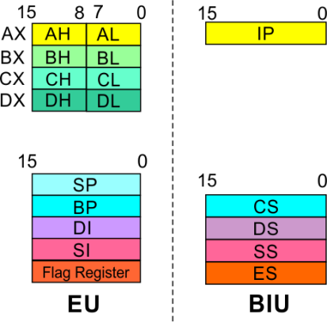
Addressing Modes
8086 Microprocessor
Group I : Addressing modes for register and immediate data
Register Addressing
Immediate Addressing
Direct Addressing
Register Indirect Addressing
Based Addressing
Indexed Addressing
Based Index Addressing
String Addressing
Direct I/O port Addressing
10. Indirect I/O port Addressing
11. Relative Addressing
12. Implied Addressing
The instruction will specify the name of the register which holds the data to be operated by the instruction.
Example:
MOV CL, DH
The content of 8-bit register DH is moved to another 8-bit register CL
(CL) ← (DH)

Slide 8

Addressing Modes
8086 Microprocessor
Group I : Addressing modes for register and immediate data
Register Addressing
Immediate Addressing
Direct Addressing
Register Indirect Addressing
Based Addressing
Indexed Addressing
Based Index Addressing
String Addressing
Direct I/O port Addressing
10. Indirect I/O port Addressing
11. Relative Addressing
12. Implied Addressing
In immediate addressing mode, an 8-bit or 16-bit data is specified as part of the instruction
Example:
MOV DL, 08H
The 8-bit data (08_{H}) given in the instruction is moved to DL
(DL) ← 08_{H}
MOV AX, 0A9FH
The 16-bit data (0A9F_{H}) given in the instruction is moved to AX register
(AX) ← 0A9F_{H}

Slide 9
Addressing Modes : Memory Access
8086 Microprocessor
Offset Value (16 bits)
Segment Register (16 bits)
0 0 0 0
Adder
Physical Address (20 Bits)

Slide 10
Addressing Modes : Memory Access
8086 Microprocessor
20 Address lines ⇒ 8086 can address up to 2²⁰ = 1M bytes of memory
However, the largest register is only 16 bits
Physical Address will have to be calculated Physical Address : Actual address of a byte in memory. i.e. the value which goes out onto the address bus.
Memory Address represented in the form – Seg : Offset (Eg - 89AB:F012)
Each time the processor wants to access memory, it takes the contents of a segment register, shifts it one hexadecimal place to the left (same as multiplying by 16₁₀), then add the required offset to form the 20- bit address
16 bytes of contiguous memory
89AB : F012 → 89AB → 89AB0 (Paragraph to byte → 89AB x 10 = 89AB0)
F012 → 0F012 (Offset is already in byte unit)
+ -------
98AC2 (The absolute address)

Slide 11
Addressing Modes : Memory Access
8086 Microprocessor
To access memory we use these four registers: BX, SI, DI, BP
Combining these registers inside [ ] symbols, we can get different memory locations (Effective Address, EA)
Supported combinations:
[BX + SI] [BX + DI] [BP + SI] [BP + DI] | [SI] [DI] d16 (variable offset only) [BX] | [BX + SI + d8] [BX + DI + d8] [BP + SI + d8] [BP + DI + d8]
[SI + d8] [DI + d8] [BP + d8] [BX + d8] | [BX + SI + d16] [BX + DI + d16] [BP + SI + d16] [BP + DI + d16] | [SI + d16] [DI + d16] [BP + d16] [BX + d16]
BX BP | SI DI | + disp

Slide 12
Addressing Modes
8086 Microprocessor
Group II : Addressing modes for memory data
Register Addressing
Immediate Addressing
Direct Addressing
Register Indirect Addressing
Based Addressing
Indexed Addressing
Based Index Addressing
String Addressing
Direct I/O port Addressing
10. Indirect I/O port Addressing
11. Relative Addressing
12. Implied Addressing
Here, the effective address of the memory location at which the data operand is stored is given in the instruction.
The effective address is just a 16-bit number written directly in the instruction.
Example:
MOV BX, [1354H]
MOV BL, [0400H]
The square brackets around the 1354_{H} denotes the contents of the memory location. When executed, this instruction will copy the contents of the memory location into BX register.
This addressing mode is called direct because the displacement of the operand from the segment base is specified directly in the instruction.

Slide 13
Addressing Modes
8086 Microprocessor
Group II : Addressing modes for memory data
Register Addressing
Immediate Addressing
Direct Addressing
Register Indirect Addressing
Based Addressing
Indexed Addressing
Based Index Addressing
String Addressing
Direct I/O port Addressing
10. Indirect I/O port Addressing
11. Relative Addressing
12. Implied Addressing
In Register indirect addressing, name of the register which holds the effective address (EA) will be specified in the instruction.
Registers used to hold EA are any of the following registers:
BX, BP, DI and SI.
Content of the DS register is used for base address calculation.
Example:
MOV CX, [BX]
Operations:
EA = (BX)
BA = (DS) x 16₁₀
MA = BA + EA
(CX) ← (MA) or,
(CL) ← (MA)
(CH) ← (MA +1)
Note : Register/ memory enclosed in brackets refer to content of register/ memory

Slide 14
Addressing Modes
8086 Microprocessor
Group II : Addressing modes for memory data
Register Addressing
Immediate Addressing
Direct Addressing
Register Indirect Addressing
Based Addressing
Indexed Addressing
Based Index Addressing
String Addressing
Direct I/O port Addressing
10. Indirect I/O port Addressing
11. Relative Addressing
12. Implied Addressing
In Based Addressing, BX or BP is used to hold the base value for effective address and a signed 8-bit or unsigned 16-bit displacement will be specified in the instruction.
In case of 8-bit displacement, it is sign extended to 16-bit before adding to the base value.
When BX holds the base value of EA, 20-bit physical address is calculated from BX and DS.
When BP holds the base value of EA, BP and SS is used.
Example:
MOV AX, [BX + 08H]
Operations:
0008_{H} ← 08_{H} (Sign extended)
EA = (BX) + 0008_{H}
BA = (DS) x 16₁₀
MA = BA + EA
(AX) ← (MA) or,
(AL) ← (MA)
(AH) ← (MA + 1)

Slide 15
Addressing Modes
8086 Microprocessor
Group II : Addressing modes for memory data
Register Addressing
Immediate Addressing
Direct Addressing
Register Indirect Addressing
Based Addressing
Indexed Addressing
Based Index Addressing
String Addressing
Direct I/O port Addressing
10. Indirect I/O port Addressing
11. Relative Addressing
12. Implied Addressing
SI or DI register is used to hold an index value for memory data and a signed 8-bit or unsigned 16-bit displacement will be specified in the instruction.
Displacement is added to the index value in SI or DI register to obtain the EA.
In case of 8-bit displacement, it is sign extended to 16-bit before adding to the base value.
Example:
MOV CX, [SI + 0A2H]
Operations:
FFA2_{H} ← A2_{H} (Sign extended)
EA = (SI) + FFA2_{H}
BA = (DS) x 16₁₀
MA = BA + EA
(CX) ← (MA) or,
(CL) ← (MA)
(CH) ← (MA + 1)

Slide 16
Addressing Modes
8086 Microprocessor
Group II : Addressing modes for memory data
Register Addressing
Immediate Addressing
Direct Addressing
Register Indirect Addressing
Based Addressing
Indexed Addressing
Based Index Addressing
String Addressing
Direct I/O port Addressing
10. Indirect I/O port Addressing
11. Relative Addressing
12. Implied Addressing
In Based Index Addressing, the effective address is computed from the sum of a base register (BX or BP), an index register (SI or DI) and a displacement.
Example:
MOV DX, [BX + SI + 0AH]
Operations:
000A_{H} ← 0A_{H} (Sign extended)
EA = (BX) + (SI) + 000A_{H}
BA = (DS) x 16₁₀
MA = BA + EA
(DX) ← (MA) or,
(DL) ← (MA)
(DH) ← (MA + 1)

Slide 17
Addressing Modes
8086 Microprocessor
Group II : Addressing modes for memory data
Register Addressing
Immediate Addressing
Direct Addressing
Register Indirect Addressing
Based Addressing
Indexed Addressing
Based Index Addressing
String Addressing
Direct I/O port Addressing
10. Indirect I/O port Addressing
11. Relative Addressing
12. Implied Addressing
Employed in string operations to operate on string data.
The effective address (EA) of source data is stored in SI register and the EA of destination is stored in DI register.
Segment register for calculating base address of
source data is DS and that of the destination data is ES
Example: MOVS BYTE
Operations:
Calculation of source memory location:
EA = (SI) BA = (DS) x 16₁₀ MA = BA + EA
Calculation of destination memory location:
EA_{E} = (DI) BA_{E} = (ES) x 16₁₀ MA_{E} = BA_{E} + EA_{E}
(MAE) ← (MA)
If DF = 1, then (SI) ← (SI) – 1 and (DI) = (DI) - 1
If DF = 0, then (SI) ← (SI) +1 and (DI) = (DI) + 1
Note : Effective address of the Extra segment register

Slide 18
Addressing Modes
8086 Microprocessor
Group III : Addressing modes for I/O ports
Register Addressing
Immediate Addressing
Direct Addressing
Register Indirect Addressing
Based Addressing
Indexed Addressing
Based Index Addressing
String Addressing
Direct I/O port Addressing
10. Indirect I/O port Addressing
11. Relative Addressing
12. Implied Addressing
These addressing modes are used to access data from standard I/O mapped devices or ports.
In direct port addressing mode, an 8-bit port address is directly specified in the instruction.
Example: IN AL, [09H]
Operations: PORT_{addr} = 09_{H}
(AL) ← (PORT)
Content of port with address 09_{H} is moved to AL register
In indirect port addressing mode, the instruction will specify the name of the register which holds the port address. In 8086, the 16-bit port address is stored in the DX register.
Example: OUT [DX], AX
Operations: PORT_{addr} = (DX)
(PORT) ← (AX)
Content of AX is moved to port whose address is specified by DX register.

Slide 19
Addressing Modes
8086 Microprocessor
Group IV : Relative Addressing mode
Register Addressing
Immediate Addressing
Direct Addressing
Register Indirect Addressing
Based Addressing
Indexed Addressing
Based Index Addressing
String Addressing
Direct I/O port Addressing
10. Indirect I/O port Addressing
11. Relative Addressing
12. Implied Addressing
In this addressing mode, the effective address of a program instruction is specified relative to Instruction Pointer (IP) by an 8-bit signed displacement.
Example: JZ 0AH
Operations:
000A_{H} ← 0A_{H} (sign extend)
If ZF = 1, then
EA = (IP) + 000A_{H}
BA = (CS) x 16₁₀
MA = BA + EA
If ZF = 1, then the program control jumps to new address calculated above.
If ZF = 0, then next instruction of the program is executed.

Slide 20
Addressing Modes
8086 Microprocessor
Group IV : Implied Addressing mode
Register Addressing
Immediate Addressing
Direct Addressing
Register Indirect Addressing
Based Addressing
Indexed Addressing
Based Index Addressing
String Addressing
Direct I/O port Addressing
10. Indirect I/O port Addressing
11. Relative Addressing
12. Implied Addressing
Instructions using this mode have no operands. The instruction itself will specify the data to be operated by the instruction.
Example: CLC
This clears the carry flag to zero.

Slide 21
INSTRUCTION SET

Slide 22
Instruction Set
8086 Microprocessor
8086 supports 6 types of instructions.
Data Transfer Instructions
Arithmetic Instructions
Logical Instructions
String manipulation Instructions
Process Control Instructions
Control Transfer Instructions

Slide 23
Instruction Set
8086 Microprocessor
1. Data Transfer Instructions
Instructions that are used to transfer data/ address in to registers, memory locations and I/O ports.
Generally involve two operands: Source operand and Destination operand of the same size.
Source: Register or a memory location or an immediate data
Destination : Register or a memory location.
The size should be a either a byte or a word.
A 8-bit data can only be moved to 8-bit register/ memory and a 16-bit data can be moved to 16-bit register/ memory.

Slide 24
Instruction Set
8086 Microprocessor
1. Data Transfer Instructions
Mnemonics: MOV, XCHG, PUSH, POP, IN, OUT …
MOV reg2/ mem, reg1/ mem MOV reg2, reg1 MOV mem, reg1 MOV reg2, mem | (reg2) ← (reg1) (mem) ← (reg1) (reg2) ← (mem)
MOV reg/ mem, data MOV reg, data MOV mem, data | (reg) ← data (mem) ← data
XCHG reg2/ mem, reg1 XCHG reg2, reg1 XCHG mem, reg1 | (reg2) ↔ (reg1) (mem) ↔ (reg1)

Slide 25
Instruction Set
8086 Microprocessor
1. Data Transfer Instructions
Mnemonics: MOV, XCHG, PUSH, POP, IN, OUT …
PUSH reg16/ mem PUSH reg16 PUSH mem | (SP) ← (SP) – 2 MA _{S} = (SS) x 16₁₀ + SP (MA _{S} ; MA _{S} + 1) ← (reg16) (SP) ← (SP) – 2 MA _{S} = (SS) x 16₁₀ + SP (MA _{S} ; MA _{S} + 1) ← (mem)
POP reg16/ mem POP reg16 POP mem | MA _{S} = (SS) x 16₁₀ + SP (reg16) ← (MA _{S} ; MA _{S} + 1) (SP) ← (SP) + 2 MA _{S} = (SS) x 16₁₀ + SP (mem) ← (MA _{S} ; MA _{S} + 1) (SP) ← (SP) + 2

Slide 26
Instruction Set
8086 Microprocessor
1. Data Transfer Instructions
Mnemonics: MOV, XCHG, PUSH, POP, IN, OUT …
IN A, [DX] IN AL, [DX] IN AX, [DX] | PORT_{addr} = (DX) (AL) ← (PORT) PORT_{addr} = (DX) (AX) ← (PORT)
IN A, addr8 IN AL, addr8 IN AX, addr8 | (AL) ← (addr8) (AX) ← (addr8)
OUT [DX], A OUT [DX], AL OUT [DX], AX | PORT_{addr} = (DX) (PORT) ← (AL) PORT_{addr} = (DX) (PORT) ← (AX)
OUT addr8, A OUT addr8, AL OUT addr8, AX | (addr8) ← (AL) (addr8) ← (AX)

Slide 27
Instruction Set
8086 Microprocessor
2. Arithmetic Instructions
Mnemonics: ADD, ADC, SUB, SBB, INC, DEC, MUL, DIV, CMP…
ADD reg2/ mem, reg1/mem ADD reg2, reg1 ADD reg2, mem ADD mem, reg1 | (reg2) ← (reg1) + (reg2) (reg2) ← (reg2) + (mem) (mem) ← (mem)+(reg1)
ADD reg/mem, data ADD reg, data ADD mem, data | (reg) ← (reg)+ data (mem) ← (mem)+data
ADD A, data ADD AL, data8 ADD AX, data16 | (AL) ← (AL) + data8 (AX) ← (AX) +data16

Slide 28
Instruction Set
8086 Microprocessor
2. Arithmetic Instructions
Mnemonics: ADD, ADC, SUB, SBB, INC, DEC, MUL, DIV, CMP…
ADC reg2/ mem, reg1/mem ADC reg2, reg1 ADC reg2, mem ADC mem, reg1 | (reg2) ← (reg1) + (reg2)+CF (reg2) ← (reg2) + (mem)+CF (mem) ← (mem)+(reg1)+CF
ADC reg/mem, data ADC reg, data ADC mem, data | (reg) ← (reg)+ data+CF (mem) ← (mem)+data+CF
ADDC A, data ADD AL, data8 ADD AX, data16 | (AL) ← (AL) + data8+CF (AX) ← (AX) +data16+CF

Slide 29
Instruction Set
8086 Microprocessor
2. Arithmetic Instructions
Mnemonics: ADD, ADC, SUB, SBB, INC, DEC, MUL, DIV, CMP…
SUB reg2/ mem, reg1/mem SUB reg2, reg1 SUB reg2, mem SUB mem, reg1 | (reg2) ← (reg1) - (reg2) (reg2) ← (reg2) - (mem) (mem) ← (mem) - (reg1)
SUB reg/mem, data SUB reg, data SUB mem, data | (reg) ← (reg) - data (mem) ← (mem) - data
SUB A, data SUB AL, data8 SUB AX, data16 | (AL) ← (AL) - data8 (AX) ← (AX) - data16

Slide 30
Instruction Set
8086 Microprocessor
2. Arithmetic Instructions
Mnemonics: ADD, ADC, SUB, SBB, INC, DEC, MUL, DIV, CMP…
SBB reg2/ mem, reg1/mem SBB reg2, reg1 SBB reg2, mem SBB mem, reg1 | (reg2) ← (reg1) - (reg2) - CF (reg2) ← (reg2) - (mem)- CF (mem) ← (mem) - (reg1) –CF
SBB reg/mem, data SBB reg, data SBB mem, data | (reg) ← (reg) – data - CF (mem) ← (mem) - data - CF
SBB A, data SBB AL, data8 SBB AX, data16 | (AL) ← (AL) - data8 - CF (AX) ← (AX) - data16 - CF

Slide 31
Instruction Set
8086 Microprocessor
2. Arithmetic Instructions
Mnemonics: ADD, ADC, SUB, SBB, INC, DEC, MUL, DIV, CMP…
INC reg/ mem INC reg8 INC reg16 INC mem | (reg8) ← (reg8) + 1 (reg16) ← (reg16) + 1 (mem) ← (mem) + 1
DEC reg/ mem DEC reg8 DEC reg16 DEC mem | (reg8) ← (reg8) - 1 (reg16) ← (reg16) - 1 (mem) ← (mem) - 1

Slide 32
Instruction Set
8086 Microprocessor
2. Arithmetic Instructions
Mnemonics: ADD, ADC, SUB, SBB, INC, DEC, MUL, DIV, CMP…
MUL reg/ mem MUL reg MUL mem | For byte : (AX) ← (AL) x (reg8) For word : (DX)(AX) ← (AX) x (reg16) For byte : (AX) ← (AL) x (mem8) For word : (DX)(AX) ← (AX) x (mem16)
IMUL reg/ mem IMUL reg IMUL mem | For byte : (AX) ← (AL) x (reg8) For word : (DX)(AX) ← (AX) x (reg16) For byte : (AX) ← (AX) x (mem8) For word : (DX)(AX) ← (AX) x (mem16)

Slide 33
Instruction Set
8086 Microprocessor
2. Arithmetic Instructions
Mnemonics: ADD, ADC, SUB, SBB, INC, DEC, MUL, DIV, CMP…
DIV reg/ mem DIV reg DIV mem | For 16-bit :- 8-bit : (AL) ← (AX) :- (reg8) Quotient (AH) ← (AX) MOD(reg8) Remainder For 32-bit :- 16-bit : (AX) ← (DX)(AX) :- (reg16) Quotient (DX) ← (DX)(AX) MOD(reg16) Remainder For 16-bit :- 8-bit : (AL) ← (AX) :- (mem8) Quotient (AH) ← (AX) MOD(mem8) Remainder For 32-bit :- 16-bit : (AX) ← (DX)(AX) :- (mem16) Quotient (DX) ← (DX)(AX) MOD(mem16) Remainder

Slide 34
Instruction Set
8086 Microprocessor
2. Arithmetic Instructions
Mnemonics: ADD, ADC, SUB, SBB, INC, DEC, MUL, DIV, CMP…
IDIV reg/ mem IDIV reg IDIV mem | For 16-bit :- 8-bit : (AL) ← (AX) :- (reg8) Quotient (AH) ← (AX) MOD(reg8) Remainder For 32-bit :- 16-bit : (AX) ← (DX)(AX) :- (reg16) Quotient (DX) ← (DX)(AX) MOD(reg16) Remainder For 16-bit :- 8-bit : (AL) ← (AX) :- (mem8) Quotient (AH) ← (AX) MOD(mem8) Remainder For 32-bit :- 16-bit : (AX) ← (DX)(AX) :- (mem16) Quotient (DX) ← (DX)(AX) MOD(mem16) Remainder

Slide 35
Instruction Set
8086 Microprocessor
2. Arithmetic Instructions
Mnemonics: ADD, ADC, SUB, SBB, INC, DEC, MUL, DIV, CMP…
CMP reg2/mem, reg1/ mem CMP reg2, reg1 CMP reg2, mem CMP mem, reg1 | Modify flags ← (reg2) – (reg1) If (reg2) > (reg1) then CF=0, ZF=0, SF=0 If (reg2) < (reg1) then CF=1, ZF=0, SF=1 If (reg2) = (reg1) then CF=0, ZF=1, SF=0 Modify flags ← (reg2) – (mem) If (reg2) > (mem) then CF=0, ZF=0, SF=0 If (reg2) < (mem) then CF=1, ZF=0, SF=1 If (reg2) = (mem) then CF=0, ZF=1, SF=0 Modify flags ← (mem) – (reg1) If (mem) > (reg1) then CF=0, ZF=0, SF=0 If (mem) < (reg1) then CF=1, ZF=0, SF=1 If (mem) = (reg1) then CF=0, ZF=1, SF=0

Slide 36
Instruction Set
8086 Microprocessor
2. Arithmetic Instructions
Mnemonics: ADD, ADC, SUB, SBB, INC, DEC, MUL, DIV, CMP…
CMP reg/mem, data CMP reg, data CMP mem, data | Modify flags ← (reg) – (data) If (reg) > data then CF=0, ZF=0, SF=0 If (reg) < data then CF=1, ZF=0, SF=1 If (reg) = data then CF=0, ZF=1, SF=0 Modify flags ← (mem) – (mem) If (mem) > data then CF=0, ZF=0, SF=0 If (mem) < data then CF=1, ZF=0, SF=1 If (mem) = data then CF=0, ZF=1, SF=0

Slide 37
Instruction Set
8086 Microprocessor
2. Arithmetic Instructions
Mnemonics: ADD, ADC, SUB, SBB, INC, DEC, MUL, DIV, CMP…
CMP A, data CMP AL, data8 CMP AX, data16 | Modify flags ← (AL) – data8 If (AL) > data8 then CF=0, ZF=0, SF=0 If (AL) < data8 then CF=1, ZF=0, SF=1 If (AL) = data8 then CF=0, ZF=1, SF=0 Modify flags ← (AX) – data16 If (AX) > data16 then CF=0, ZF=0, SF=0 If (mem) < data16 then CF=1, ZF=0, SF=1 If (mem) = data16 then CF=0, ZF=1, SF=0

Slide 38
Instruction Set
8086 Microprocessor
3. Logical Instructions
Mnemonics: AND, OR, XOR, TEST, SHR, SHL, RCR, RCL …

Slide 39
Instruction Set
8086 Microprocessor
3. Logical Instructions
Mnemonics: AND, OR, XOR, TEST, SHR, SHL, RCR, RCL …

Slide 40
Instruction Set
8086 Microprocessor
3. Logical Instructions
Mnemonics: AND, OR, XOR, TEST, SHR, SHL, RCR, RCL …

Slide 41
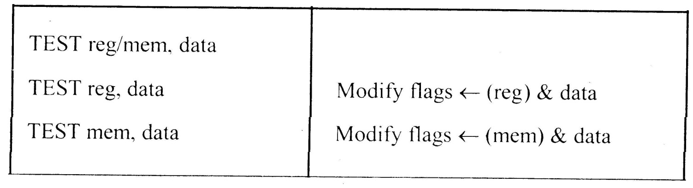
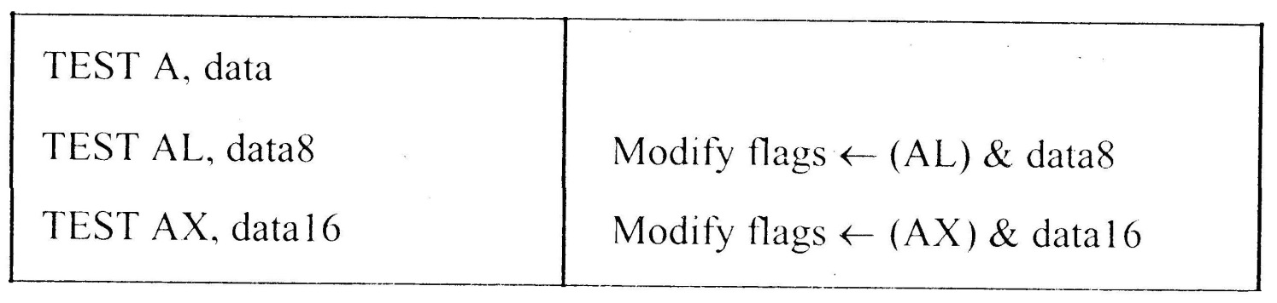
Instruction Set
8086 Microprocessor
3. Logical Instructions
Mnemonics: AND, OR, XOR, TEST, SHR, SHL, RCR, RCL …

Slide 42
Instruction Set
8086 Microprocessor
3. Logical Instructions
Mnemonics: AND, OR, XOR, TEST, SHR, SHL, RCR, RCL …

Slide 43
Instruction Set
8086 Microprocessor
3. Logical Instructions
Mnemonics: AND, OR, XOR, TEST, SHR, SHL, RCR, RCL …

Slide 44
Instruction Set
8086 Microprocessor
3. Logical Instructions
Mnemonics: AND, OR, XOR, TEST, SHR, SHL, RCR, RCL …

Slide 45
Instruction Set
8086 Microprocessor
3. Logical Instructions
Mnemonics: AND, OR, XOR, TEST, SHR, SHL, RCR, RCL …

Slide 46
Instruction Set
8086 Microprocessor
4. String Manipulation Instructions
String : Sequence of bytes or words
8086 instruction set includes instruction for string movement, comparison, scan, load and store.
REP instruction prefix : used to repeat execution of string instructions
String instructions end with S or SB or SW.
S represents string, SB string byte and SW string word.
Offset or effective address of the source operand is stored in SI register and that of the destination operand is stored in DI register.
Depending on the status of DF, SI and DI registers are automatically updated.
DF = 0 ⇒ SI and DI are incremented by 1 for byte and 2 for word.
DF = 1 ⇒ SI and DI are decremented by 1 for byte and 2 for word.

Slide 47
Instruction Set
8086 Microprocessor
4. String Manipulation Instructions
Mnemonics: REP, MOVS, CMPS, SCAS, LODS, STOS
REP REPZ/ REPE (Repeat CMPS or SCAS until ZF = 0) REPNZ/ REPNE (Repeat CMPS or SCAS until ZF = 1) | While CX ≠ 0 and ZF = 1, repeat execution of string instruction and (CX) ← (CX) – 1 While CX ≠ 0 and ZF = 0, repeat execution of string instruction and (CX) ← (CX) - 1

Slide 48
Instruction Set
8086 Microprocessor
4. String Manipulation Instructions
Mnemonics: REP, MOVS, CMPS, SCAS, LODS, STOS
MOVS MOVSB MOVSW | MA = (DS) x 16₁₀ + (SI) MA_{E} = (ES) x 16₁₀ + (DI) (MA_{E}) ← (MA) If DF = 0, then (DI) ← (DI) + 1; (SI) ← (SI) + 1 If DF = 1, then (DI) ← (DI) - 1; (SI) ← (SI) - 1 MA = (DS) x 16₁₀ + (SI) MA_{E} = (ES) x 16₁₀ + (DI) (MA_{E} ; MA_{E} + 1) ← (MA; MA + 1) If DF = 0, then (DI) ← (DI) + 2; (SI) ← (SI) + 2 If DF = 1, then (DI) ← (DI) - 2; (SI) ← (SI) - 2

Slide 49
Instruction Set
8086 Microprocessor
4. String Manipulation Instructions
Mnemonics: REP, MOVS, CMPS, SCAS, LODS, STOS
Compare two string byte or string word
CMPS CMPSB CMPSW | MA = (DS) x 16₁₀ + (SI) MA_{E} = (ES) x 16₁₀ + (DI) Modify flags ← (MA) - (MA_{E}) If (MA) > (MA_{E}), then CF = 0; ZF = 0; SF = 0 If (MA) < (MA_{E}), then CF = 1; ZF = 0; SF = 1 If (MA) = (MA_{E}), then CF = 0; ZF = 1; SF = 0 For byte operation If DF = 0, then (DI) ← (DI) + 1; (SI) ← (SI) + 1 If DF = 1, then (DI) ← (DI) - 1; (SI) ← (SI) - 1 For word operation If DF = 0, then (DI) ← (DI) + 2; (SI) ← (SI) + 2 If DF = 1, then (DI) ← (DI) - 2; (SI) ← (SI) - 2

Slide 50
Instruction Set
8086 Microprocessor
4. String Manipulation Instructions
Mnemonics: REP, MOVS, CMPS, SCAS, LODS, STOS
Scan (compare) a string byte or word with accumulator
SCAS SCASB SCASW | MA_{E} = (ES) x 16₁₀ + (DI) Modify flags ← (AL) - (MA_{E}) If (AL) > (MA_{E}), then CF = 0; ZF = 0; SF = 0 If (AL) < (MA_{E}), then CF = 1; ZF = 0; SF = 1 If (AL) = (MA_{E}), then CF = 0; ZF = 1; SF = 0 If DF = 0, then (DI) ← (DI) + 1 If DF = 1, then (DI) ← (DI) – 1 MA_{E} = (ES) x 16₁₀ + (DI) Modify flags ← (AL) - (MA_{E}) If (AX) > (MA_{E} ; MA_{E} + 1), then CF = 0; ZF = 0; SF = 0 If (AX) < (MA_{E} ; MA_{E} + 1), then CF = 1; ZF = 0; SF = 1 If (AX) = (MA_{E} ; MA_{E} + 1), then CF = 0; ZF = 1; SF = 0 If DF = 0, then (DI) ← (DI) + 2 If DF = 1, then (DI) ← (DI) – 2

Slide 51
Instruction Set
8086 Microprocessor
4. String Manipulation Instructions
Mnemonics: REP, MOVS, CMPS, SCAS, LODS, STOS
Load string byte in to AL or string word in to AX
LODS LODSB LODSW | MA = (DS) x 16₁₀ + (SI) (AL) ← (MA) If DF = 0, then (SI) ← (SI) + 1 If DF = 1, then (SI) ← (SI) – 1 MA = (DS) x 16₁₀ + (SI) (AX) ← (MA ; MA + 1) If DF = 0, then (SI) ← (SI) + 2 If DF = 1, then (SI) ← (SI) – 2

Slide 52
Instruction Set
8086 Microprocessor
4. String Manipulation Instructions
Mnemonics: REP, MOVS, CMPS, SCAS, LODS, STOS
Store byte from AL or word from AX in to string
STOS STOSB STOSW | MA_{E} = (ES) x 16₁₀ + (DI) (MA_{E}) ← (AL) If DF = 0, then (DI) ← (DI) + 1 If DF = 1, then (DI) ← (DI) – 1 MA_{E} = (ES) x 16₁₀ + (DI) (MA_{E} ; MA_{E} + 1 ) ← (AX) If DF = 0, then (DI) ← (DI) + 2 If DF = 1, then (DI) ← (DI) – 2

Slide 53
Instruction Set
8086 Microprocessor
5. Processor Control Instructions
Mnemonics | Explanation
STC | Set CF ← 1
CLC | Clear CF ← 0
CMC | Complement carry CF ← CF/
STD | Set direction flag DF ← 1
CLD | Clear direction flag DF ← 0
STI | Set interrupt enable flag IF ← 1
CLI | Clear interrupt enable flag IF ← 0
NOP | No operation
HLT | Halt after interrupt is set
WAIT | Wait for TEST pin active
ESC opcode mem/ reg | Used to pass instruction to a coprocessor which shares the address and data bus with the 8086
LOCK | Lock bus during next instruction

Slide 54
Instruction Set
8086 Microprocessor
6. Control Transfer Instructions
Transfer the control to a specific destination or target instruction
Do not affect flags
8086 Unconditional transfers
Mnemonics | Explanation
CALL reg/ mem/ disp16 | Call subroutine
RET | Return from subroutine
JMP reg/ mem/ disp8/ disp16 | Unconditional jump

Slide 55
Instruction Set
8086 Microprocessor
6. Control Transfer Instructions
8086 signed conditional branch instructions
8086 unsigned conditional branch instructions
Checks flags
If conditions are true, the program control is transferred to the new memory location in the same segment by modifying the content of IP

Slide 56
Instruction Set
8086 Microprocessor
6. Control Transfer Instructions
8086 signed conditional branch instructions
8086 unsigned conditional branch instructions
Name | Alternate name
JE disp8 Jump if equal | JZ disp8 Jump if result is 0
JNE disp8 Jump if not equal | JNZ disp8 Jump if not zero
JG disp8 Jump if greater | JNLE disp8 Jump if not less or equal
JGE disp8 Jump if greater than or equal | JNL disp8 Jump if not less
JL disp8 Jump if less than | JNGE disp8 Jump if not greater than or equal
JLE disp8 Jump if less than or equal | JNG disp8 Jump if not greater
Name | Alternate name
JE disp8 Jump if equal | JZ disp8 Jump if result is 0
JNE disp8 Jump if not equal | JNZ disp8 Jump if not zero
JA disp8 Jump if above | JNBE disp8 Jump if not below or equal
JAE disp8 Jump if above or equal | JNB disp8 Jump if not below
JB disp8 Jump if below | JNAE disp8 Jump if not above or equal
JBE disp8 Jump if below or equal | JNA disp8 Jump if not above

Slide 57
Instruction Set
8086 Microprocessor
6. Control Transfer Instructions
8086 conditional branch instructions affecting individual flags
Mnemonics | Explanation
JC disp8 | Jump if CF = 1
JNC disp8 | Jump if CF = 0
JP disp8 | Jump if PF = 1
JNP disp8 | Jump if PF = 0
JO disp8 | Jump if OF = 1
JNO disp8 | Jump if OF = 0
JS disp8 | Jump if SF = 1
JNS disp8 | Jump if SF = 0
JZ disp8 | Jump if result is zero, i.e, Z = 1
JNZ disp8 | Jump if result is not zero, i.e, Z = 1

Slide 58

Data Transfer Instructions
LEA: Load Effective Address
The general format of LEA instruction is
LEA register, source
This instruction determines the offset address of the variable or memory location named as the source and puts this offset address in the indicated 16 bit register.
Examples:
LEA BX, COST; Load BX with offset address of COST in data segment where
COST is the name assigned to a memory location in data segment.
LEA CX, [BX][SI]; Load CX with the value equal to (BX)+(SI) where (BX) and
(SI) represents content of BX and SI respectively.

Slide 59
Data Transfer Instructions
LDS: Load register and DS with words from memory
The general form of this instruction is
LDS register, memory address of first word
The LDS instruction copies a word from the memory location specified in the instruction into the register and then copies a word from the next memory location into the DS register.
LDS is useful for initializing SI and DS registers at the start of a string before using one of the String instructions.
Example:
LDS SI,[2000H]; Copy content of memory at offset address 2000H in data segment to lower byte of SI, content of 2001H to higher byte of SI. Copy content at offset address 2002H in data segment to lower byte of DS and 2003H to higher byte of DS.

Slide 60
Data Transfer Instructions
LES, LSS: LES and LSS instructions are similar to LDS instruction except that instead of DS register, ES and SS registers are loaded respectively along with the register specified in the instruction.
LAHF: This instruction copies the low byte of flag register into AH.
SAHF: Store content of AH in the low byte of flag register.
Except SAHF and POPF instructions, all other data transfer instructions do not affect flag register.

Slide 61
Arithmetic Instructions
DAA: Decimal Adjust AL after BCD addition
This instruction is used to get the result of adding two packed BCD numbers (two decimal digits are represented in 8 bits) to be a BCD number. The result of addition must be in AL for DAA to work correctly. If the lower nibble (4 bits) in AL is greater than 9 after addition or AF flag is set by the addition then the DAA will add 6 to the lower nibble in AL. If the result in the upper nibble of AL is now greater than 9 or if the carry flag is set by the addition, then the DAA will add 60H to AL.
Examples:
Let AL=0101 1000=58 BCD
CL=0011 0101=35 BCD
Consider the execution of the following instructions:
ADD AL, CL; AL=10001101=8DH and AF=0 after execution
DAA - Add 0110 (decimal 6) to AL since lower nibble in AL is greater than 9
AL=10010011= 93 BCD and CF=0
Therefore the result of addition is 93 BCD.

Slide 62
Arithmetic Instructions
DAS: Decimal Adjust after BCD subtraction
DAS is used to get the result is in correct packed BCD form after subtracting two packed BCD numbers. The result of the subtraction must be in AL for DAS to work correctly. If the lower nibble in AL after a subtraction is greater than 9 or the AF was set by subtraction then the DAS will subtract 6 from the lower nibble of AL. If the result in the upper nibble is now greater than 9 or if the carry flag was set, the DAS will subtract 60H from AL.
Examples:
Let AL=86 BCD=1000 0110
CH=57 BCD=0101 0111
Consider the execution of the following instructions:
SUB AL, CH; AL=0010 1111=2FH and CF=0 after execution
DAS; Lower nibble of result is 1111, so DAS subtracts 06H from AL to make
AL=0010 1001=29 BCD and CF=0 to indicate there is no borrow.
The result is 29 BCD.

Slide 63
AAA: ASCII AFTER ADDITION

Slide 64
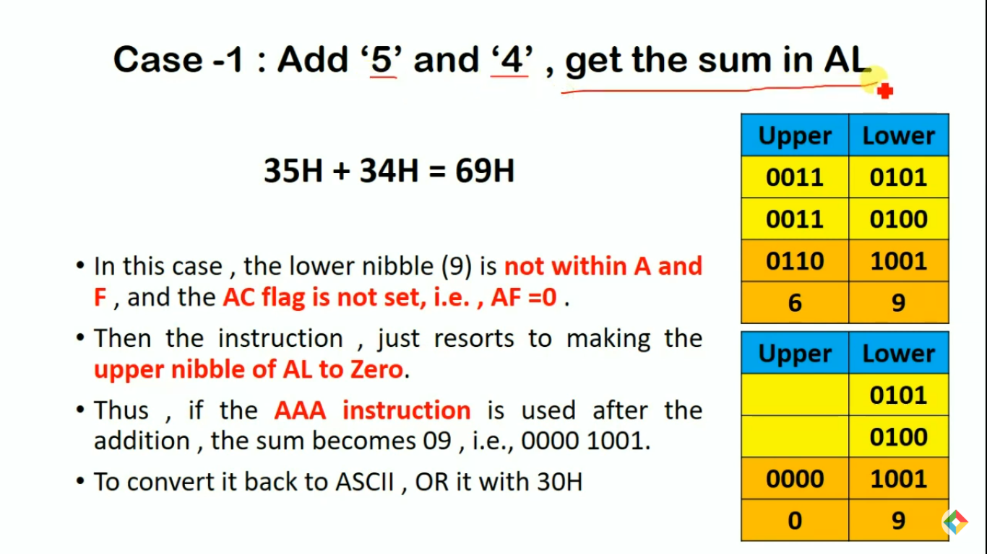

Slide 65
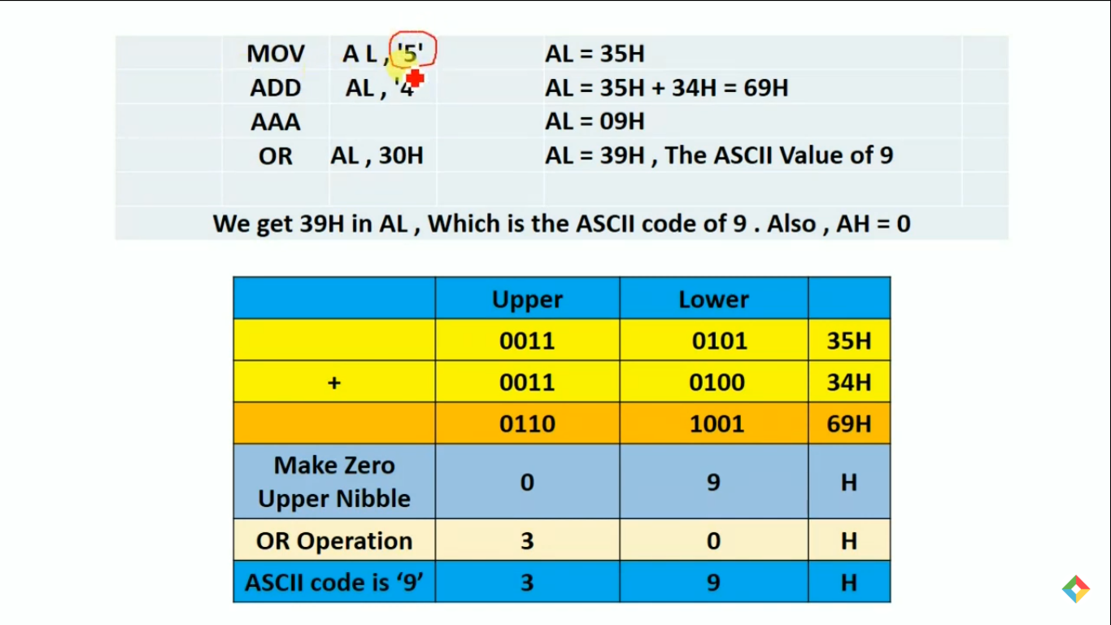

Slide 66
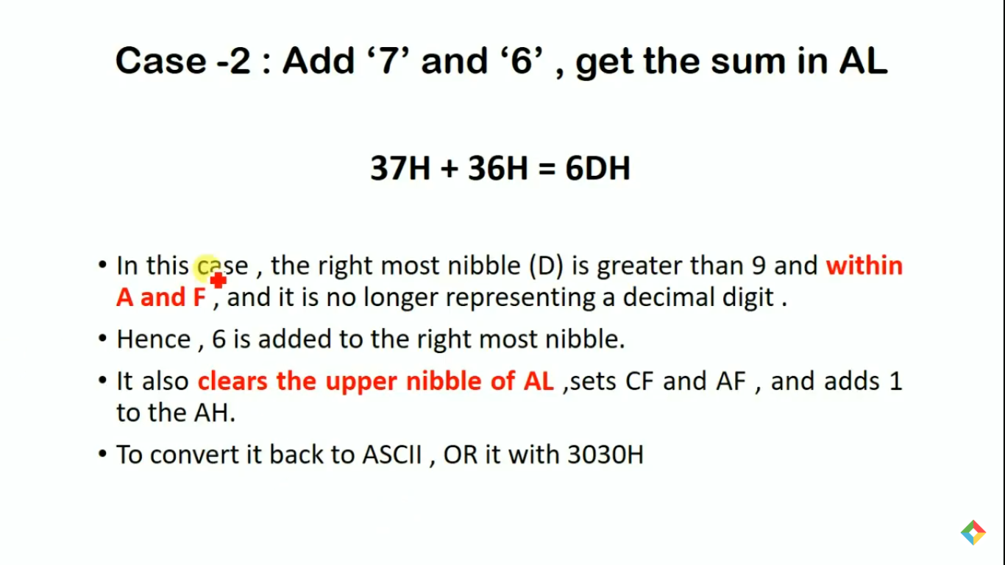

Slide 67
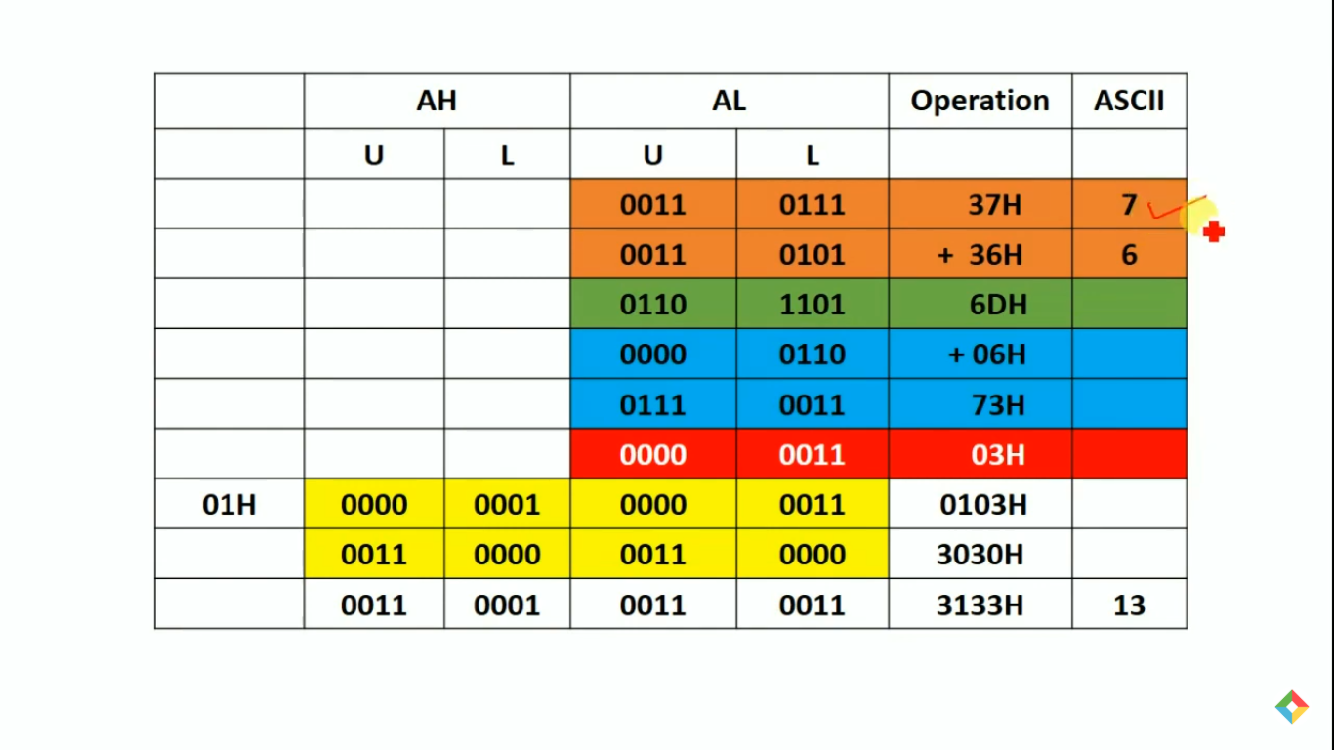

Slide 68
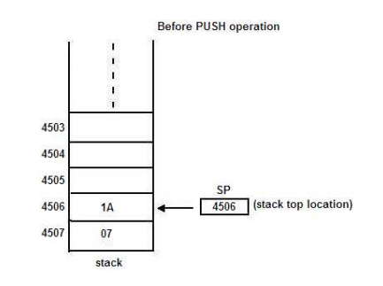
Stack Structure
Picture Courtesy :Google
Stack is a set of memory locations in the Read/Write memory which is used for temporary storage of binary information during the execution of a program.
It is implemented in the Last-in-first-out (LIFO) manner. i.e., the data written first can be accessed last, One can put the data on the top of the stack by a special operation known as PUSH.
Data can be read or taken out from the top of the stack by another special instruction known as POP.

Slide 69
Stack Structure
Stack is implemented in two ways. In the first case, a set of registers is arranged in a shift register organization.
One can PUSH or POP data from the top register. The whole block of data moves up or down as a result of push and pop operations respectively.
In the second case, a block of RAM area is allocated to the stack. A special purpose register known as stack pointer (SP) points to the top of the stack.
Whenever the stack is empty, it points to the bottom address. If a PUSH operation is performed, the data are stored at the location pointed to by SP and it is decremented by one. Similarly if the POP operation is performed, the data are taken out of the location pointed at by SP and SP is incremented by one. In this case the data do not move but SP is incremented or decremented as a result of push or pop operations respectively

Slide 70
Stack Structure
Application of Stack: Stack provides a powerful data structure which has applications in many situations. The main advantage of the stack is that, We can store data (PUSH) in it with out destroying previously stored data.
This is not true in the case of other registers and memory locations. stack operations are also very fast The stack may also be used for storing local variables of subroutine and for the transfer of parameter addresses to a subroutine.
This facilitates the implementation of re-entrant subroutines which is a very important software property. The disadvantage is, as the stack has no fixed address, it is difficult to debug and document a program that uses stack.

Slide 71
Stack Operation
Stack operation: Operations on stack are performed using the two instructions namely PUSH and POP. The contents of the stack are moved to certain memory locations after PUSH instruction.
Similarly, the contents of the memory are transferred back to registers by POP instruction.

Slide 72
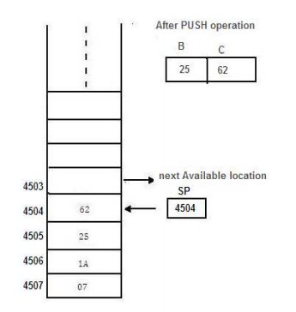
The PUSH operation of the Stack
Let us consider two registers (register pair) B & C whose contents are 25 & 62.
Picture Courtesy :Google

Slide 73
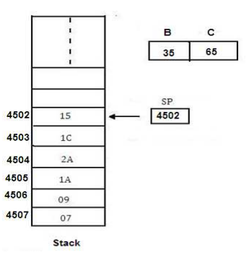
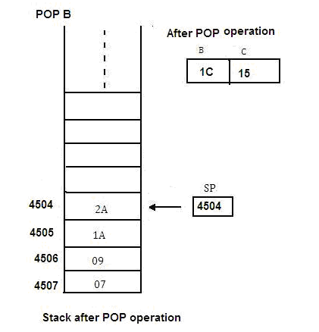
The POP operation of the Stack
Picture Courtesy :Google

Slide 74
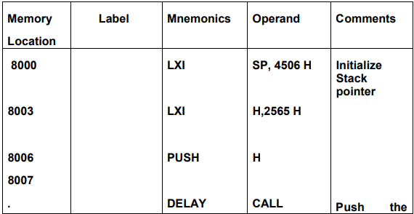
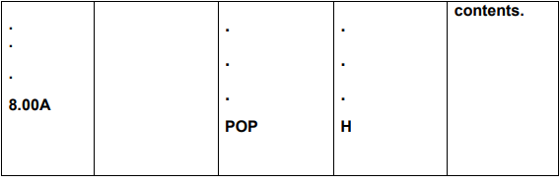
Example program
Write a program to initialize the stack pointer (SP) and store the contents of the register pair HL on stack by using PUSH instruction. Use the contents of the register pair for delay counter and at the end of the delay retrieve the contents of H-L using POP.
Picture Courtesy :Google

Slide 75
Interrupts
The meaning of ‘interrupts’ is to break the sequence of operation
While the CPU is executing a program, an interrupt breaks the normal sequence of execution of instructions, diverts its execution to some other program called Interrupt Service Routine (ISR)
After executing ISR , the control is transferred back again to the main program 8086 Interrupts and Interrupt Response

Slide 76
Types of Interrupt
An 8086 interrupt can come from any one of the three sources
One source is an external signal applied to the Non Maskable Interrupt (NMI) input pin or to the Interrupt (INTR) input pin
An interrupt caused by a signal applied to one of these inputs is referred to as a hardware interrupt
A second source of an interrupt is execution of the Interrupt instruction, INT, This is referred to as Software Interrupt
The third source of an interrupt is some error condition produced in the 8086 by the execution of an instruction
An example of this is the divide by zero error

Slide 77
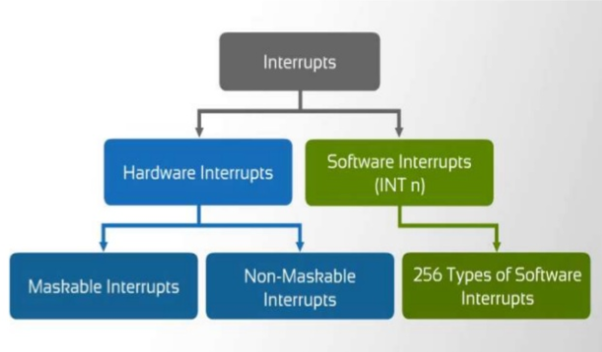
Types of Interrupt
Picture Courtesy :Google

Slide 78
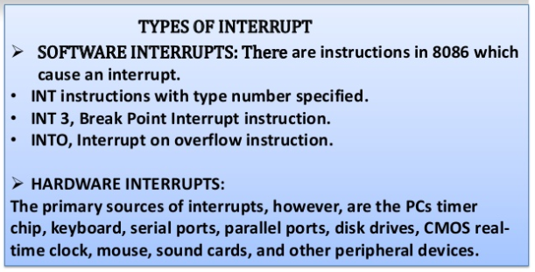
Types of Interrupt
Picture Courtesy :Google

Slide 79
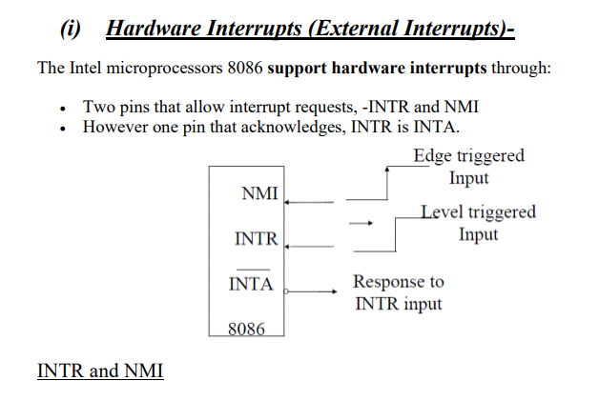
Hardware Interrupt
Picture Courtesy :Google

Slide 80
Software Interrupts
The interrupt vector table contains 256 four byte entries, contains the CS:IP
Interrupt vectors for each of the 256 possible interrupts. The table is used to locate the interrupt service routine addresses for each of those interrupts.
The Interrupt vector table is located in the first 1024 bytes of memory at addresses 000000H-0003FFH.It contains the address(segment and offset)of the interrupt service provider

Slide 81
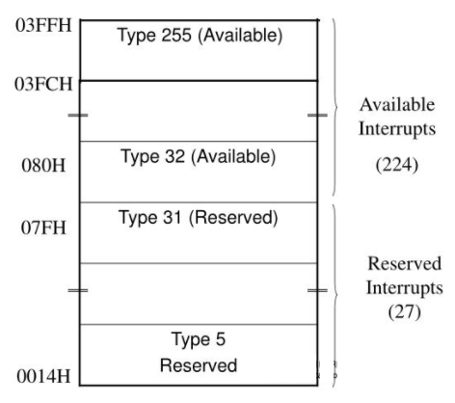
Software Interrupts
The first five interrupt vectors are identical in all Intel processors
Intel reserves the first 32 interrupt vectors
The last 224 vectors are user available
Each is four bytes long in real mode and contains the starting address of the interrupt service procedure.
The first two bytes contain the offset address The last two contain the segment address
Picture Courtesy :Google

Slide 82
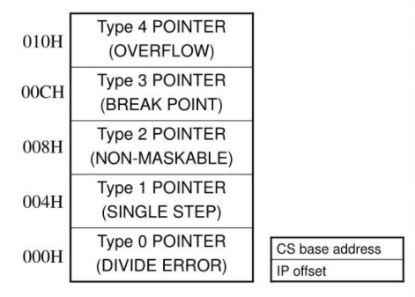
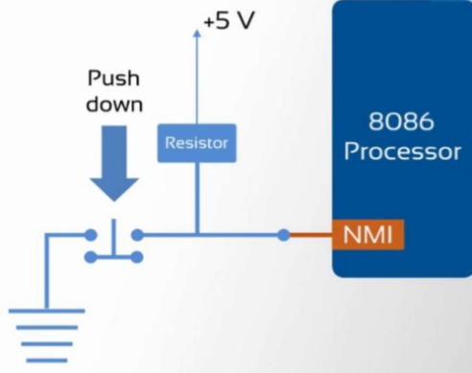
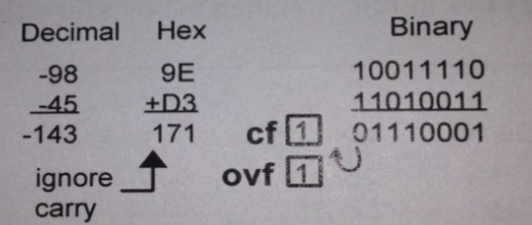
Types of Interrupts
TYPE 0 The divide error : whenever the results from a division overflows or an attempt is made to divide by zero.
Type 2 The non-maskable interrupt occurs when a logic 1 is placed on the NMI input pin to the microprocessor. non- maskable—it cannot be disabled
Type 3 A special one-byte instruction (INT 3) that uses this vector to access its interrupt-service procedure. often used to store a breakpoint in a program for debugging
TYPE 4 Overflow is a special vector used with the INTO instruction. The INTO instruction interrupts the program if an overflow condition exists.
TYPE 2
TYPE 4
Picture Courtesy :Google

